Slide 1

8259
Programmable Interrupt Controller
(SUB: Microprocessor and Interfaces)
PREPARED BY:
ER. MOHIT MISHRA
ASSOCIATE PROFESSOR
INFORMATION TECHNOLOGY

Slide 2
TOPIC COVERED
BASICS AND FEATURES OF 8259
PIN DIAGRAM AND DESCRIPTION
BLOCK DIAGRAM AND ITS DESCRIPTION

Slide 3
BASICS AND FEATURES OF 8259
The 8259 programmable interrupt controller (PIC) adds eight vectored priority encoded interrupts to the microprocessor.
It accepts request from the peripheral equipment, determine which of the incoming requests is of the highest importance
Special features of 8259:
Eight level priority controller
Expandable to 64 levels
Programmable interrupt modes
Individual request mash capability

Slide 4
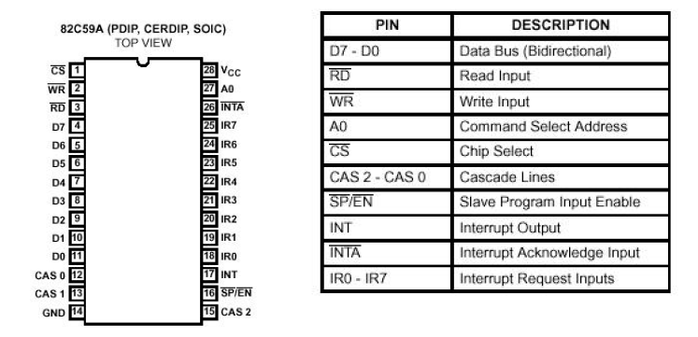
It is packaged in a 28-pin DIP, uses NMOS technology and requires a single a5V supply. Circuitry is static, requiring no clock input.
The 8259A is designed to minimize the software and real time overhead in handling multi-level priority interrupts.
It has several modes, permitting optimization for a variety of system requirements

Slide 5
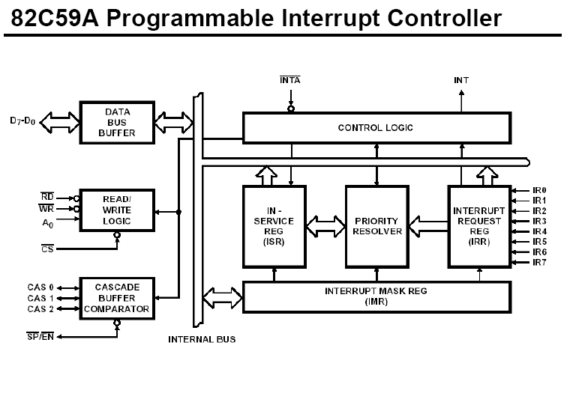

Slide 6
WORKING OF 8259 (PIC)
One or more interrupt request lines go high on service.
8259A resolves priority and sends INTR to microprocessor.
The microprocessor acknowledge the interrupts by
After , opcode for CALL intruction is placed on data bus.
Due to CALL instruction microprocessor send two more signals

Slide 7
WORKING OF 8259 (PIC) Contd…
At 1st ,8259A place lower order address on data bus.
At 2nd ,8259A place lower order address on data bus.
Program sequence now transmitted to location specified by CALL Instruction.

Slide 8
INTERRUPT REQUEST REGISTER (IRR) AND
IN-SERVICE REGISTER (ISR)
The interrupts at the IR input lines are handled by two registers in cascade, the Interrupt Request Register (IRR) and the In-Service (ISR). The IRR is used to store all the interrupt levels which are requesting service; and the ISR is used to store all the interrupt levels which are being serviced.
PRIORITY RESOLVER
This logic block determines the priorities of the bits set in the IRR. The highest priority is selected and stroed into the corresponding bit of the ISR during INTA pulse.
INTERRUPT MASK REGISTER (IMR
The IMR stores the bits which mask the interrupt lines to be masked. The IMR operates on the IRR. Masking of a higher priority input will not affect the interrupt request lines of lower quality.
INT (INTERRUPT)
This output goes directly to the CPU interrupt input. The V level on this line is designed to be fully compatible with the 8080A, 8085A and 8086 input
levels.

Slide 9
INTA (INTERRUPT ACKNOWLEDGE)
INTA pulses will cause the 8259A to release vectoring information onto the data bus. The format of this data depends on the system mode (mPM) of the 8259A.
DATA BUS BUFFER
This 3-state, bidirectional 8-bit buffer is used to interface the 8259A to the system Data Bus. Control words and status information are transferred through the Data Bus Buffer.
READ/WRITE CONTROL LOGIC
The function of this block is to accept Output commands from the CPU. It contains the Initialization Command Word (ICW) registers and Operation Command Word (OCW) registers which store the various control formats for device operation. This function block also allows the status of the 8259A to be transferred onto the Data Bus.
CS (CHIP SELECT)
A LOW on this input enables the 8259A. No reading or writing of the chip will occur unless the device is selected.
WR (WRITE)
A LOW on this input enables the CPU to write control words (ICWs and OCWs) to the 8259A.
RD (READ)
A LOW on this input enables the 8259A to send the status of the Interrupt Request Register (IRR), In Service Register (ISR), the Interrupt Mask Register (IMR), or the Interrupt level onto the Data Bus.
A0
This input signal is used in conjunction with WR and RD signals to write commands into the various command registers, as well as reading the various status registers of the chip. This line can be tied directly to one of the address lines
.

